Slide 1
6.10-6.19 文章阅读记录

Slide 2
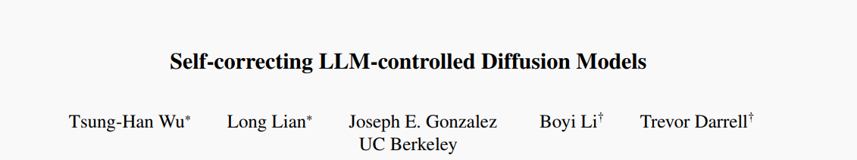
1. Self-correcting LLM-controlled Diffusion Models, CVPR 2024, UC Berkeley

Slide 3
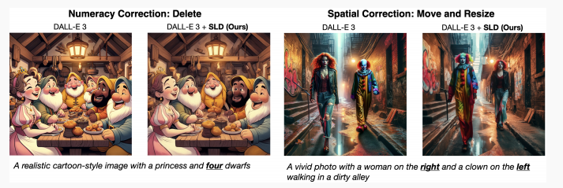
Arguments & Motivations
Existing diffusion-based text-to-image generators generally struggle to precisely generate images that correctly align with complex input prompts, especially for the ones that require numeracy and spatial relationships.
These models generate images through a predetermined number of diffusion steps and present the output to the user, regardless of its alignment with the initial user prompt.
1. Self-correcting LLM-controlled Diffusion Models, CVPR 2024, UC Berkeley

Slide 4
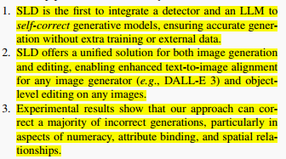
Contributions
1. Self-correcting LLM-controlled Diffusion Models, CVPR 2024, UC Berkeley

Slide 5
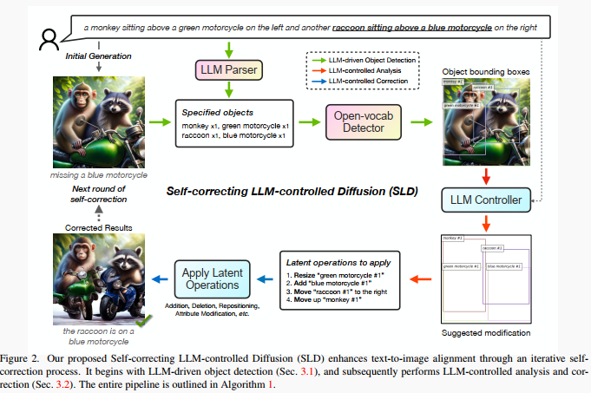
Method
1. Self-correcting LLM-controlled Diffusion Models, CVPR 2024, UC Berkeley

Slide 6
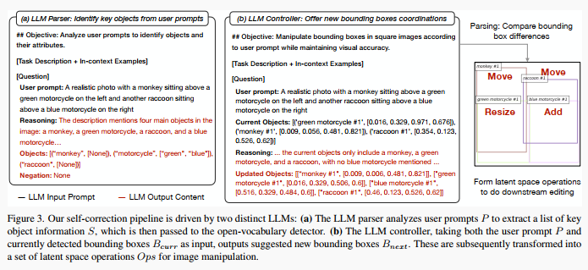
Method
1. Self-correcting LLM-controlled Diffusion Models, CVPR 2024, UC Berkeley

Slide 7
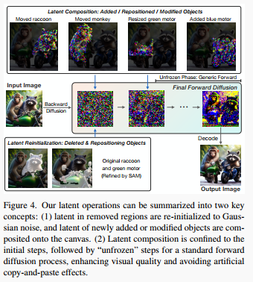
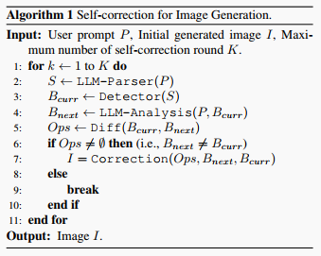
Method
Addition:
diffusion+SAM
Deletion:
SAM+Gaussian noise
Repositioning:
Deletion+Addition
Attribute modification
SAM+DiffEdit
1. Self-correcting LLM-controlled Diffusion Models, CVPR 2024, UC Berkeley

Slide 8
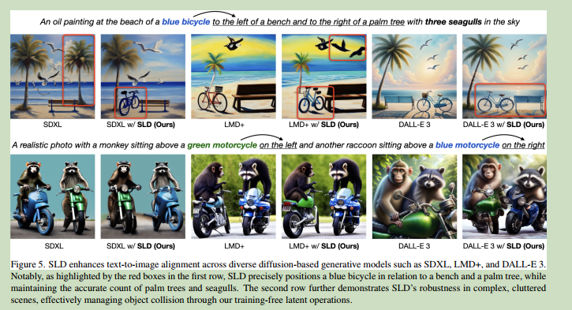
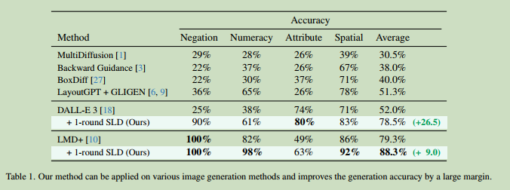
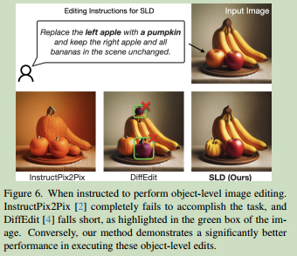
Experiments
1. Self-correcting LLM-controlled Diffusion Models, CVPR 2024, UC Berkeley

Slide 9
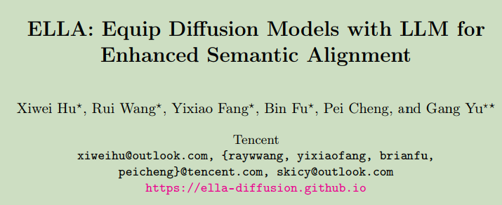
2. ELLA: Equip Diffusion Models with LLM for Enhanced Semantic Alignment, Tencent

Slide 10
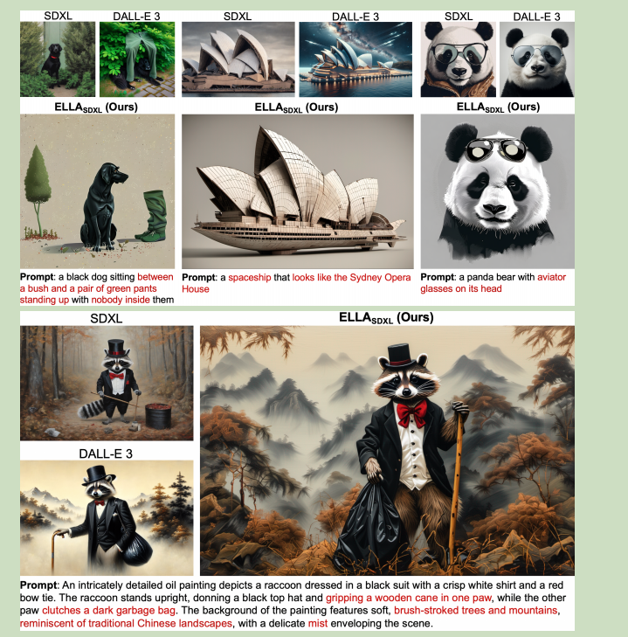
Arguments & Motivations
Most widely used models still employ CLIP as their text encoder, which constrains their ability to comprehend dense prompts…
fine-tunes the pre-trained LLM, computational cost and generalizability.
2. ELLA: Equip Diffusion Models with LLM for Enhanced Semantic Alignment, Tencent

Slide 11
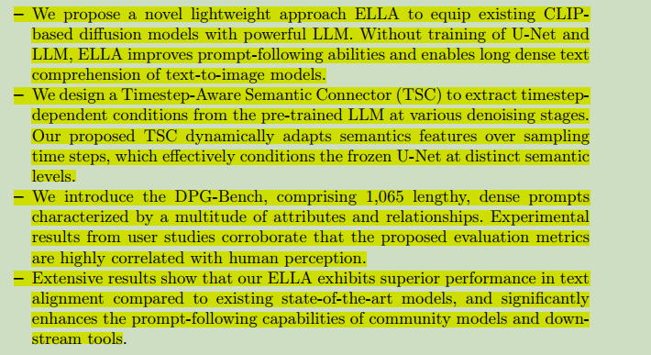
Contributions
2. ELLA: Equip Diffusion Models with LLM for Enhanced Semantic Alignment, Tencent

Slide 12
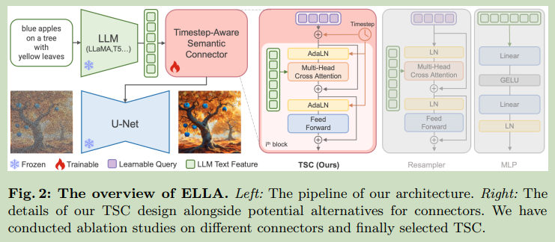
Method
融合了时间步和text feature，learnable query，模型性能可能会受 query 的影响
2. ELLA: Equip Diffusion Models with LLM for Enhanced Semantic Alignment, Tencent

Slide 13
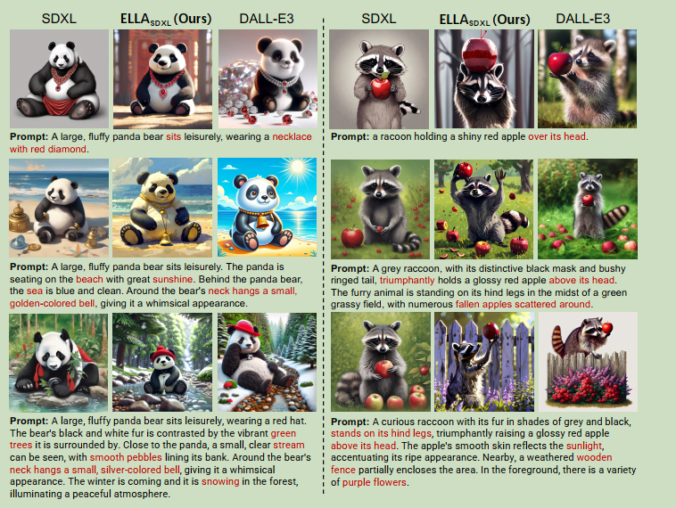
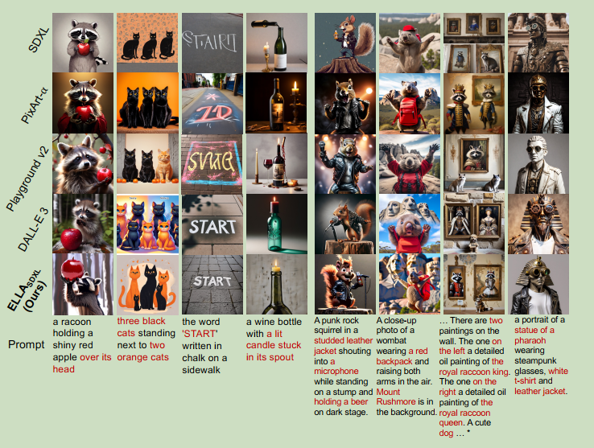
Experiments
2. ELLA: Equip Diffusion Models with LLM for Enhanced Semantic Alignment, Tencent

Slide 14
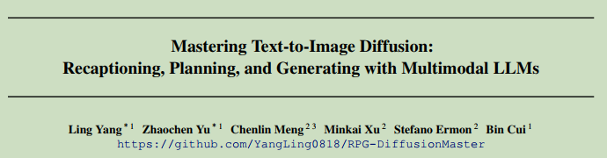
3. Mastering Text-to-Image Diffusion: Recaptioning, Planning, and Generating with Multimodal LLMs, Arxiv 2405, PKU

Slide 15
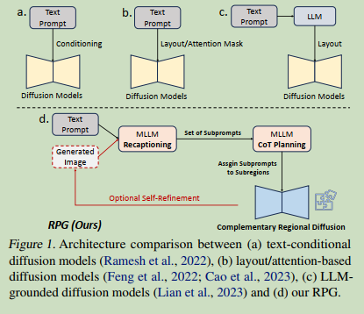
Arguments & Motivations
most diffusion models usually struggle to accurately follow some complex prompts.
(i) existing layout-based or attention-based methods can only provide roughand suboptimal spatial guidance, and struggle to deal with overlapped objects;
(ii) feedback-based methods require to collect high-quality feedback and incur additional training costs.
3. Mastering Text-to-Image Diffusion: Recaptioning, Planning, and Generating with Multimodal LLMs, Arxiv 2405, PKU

Slide 16
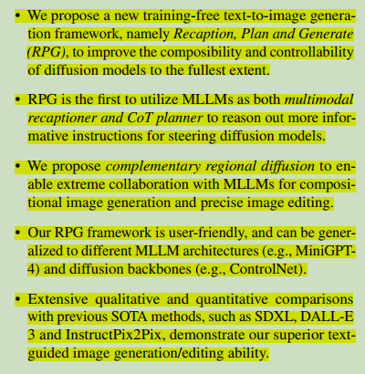
Contributions
3. Mastering Text-to-Image Diffusion: Recaptioning, Planning, and Generating with Multimodal LLMs, Arxiv 2405, PKU

Slide 17
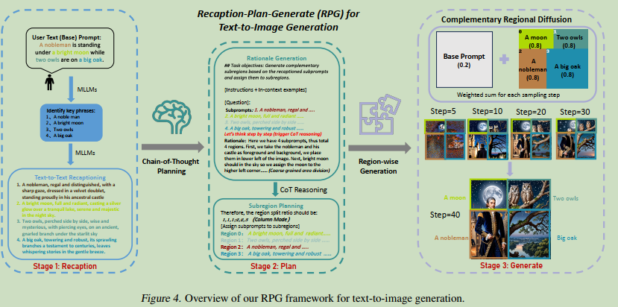
Method
如何保证重叠和临界区域的一致性？
Recaption complex prompt into a base prompt and highly descriptive subprompts.
CoT(chain of thought) planning to allocate the split prompts to complementary regions
Complementary regional diffusion to generate image latents independently and aggregate them in each step.
3. Mastering Text-to-Image Diffusion: Recaptioning, Planning, and Generating with Multimodal LLMs, Arxiv 2405, PKU

Slide 18
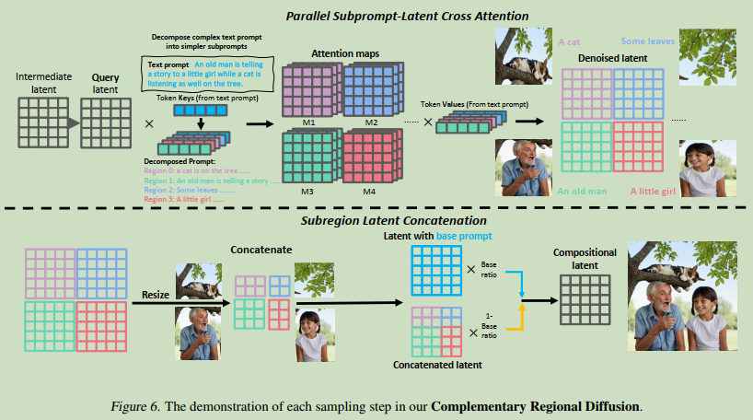
Method
Recaption complex prompt into a base prompt and highly descriptive subprompts.
CoT(chain of thought) planning to allocate the split prompts to complementary regions
Complementary regional diffusion to generate image latents independently and aggregate them in each step.
3. Mastering Text-to-Image Diffusion: Recaptioning, Planning, and Generating with Multimodal LLMs, Arxiv 2405, PKU

Slide 19
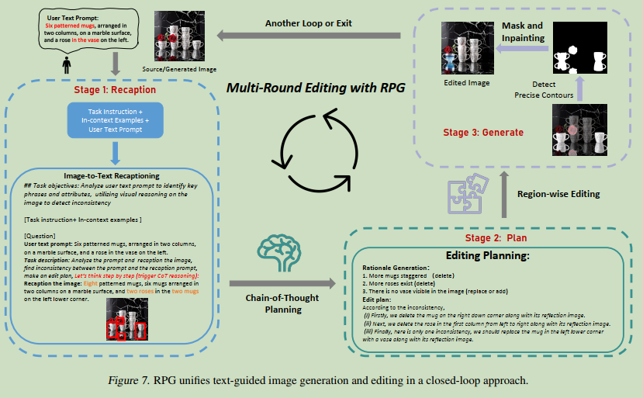
Method
Image Editing
3. Mastering Text-to-Image Diffusion: Recaptioning, Planning, and Generating with Multimodal LLMs, Arxiv 2405, PKU

Slide 20
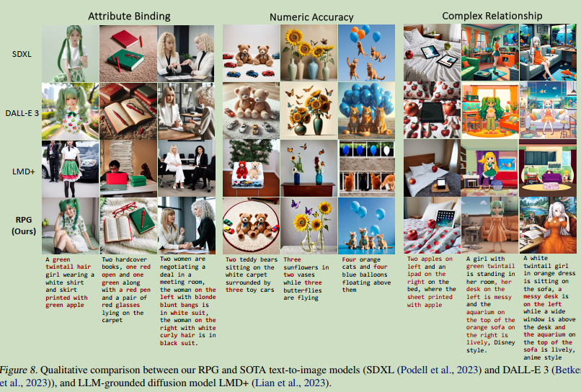
Experiments
3. Mastering Text-to-Image Diffusion: Recaptioning, Planning, and Generating with Multimodal LLMs, Arxiv 2405, PKU

Slide 21
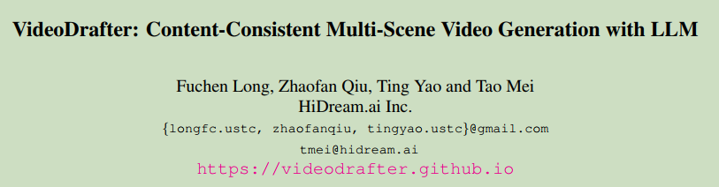
4. VideoDrafter: Content-Consistent Multi-Scene Video Generation with LLM, Arxiv 2401, HiDream

Slide 22
Arguments & Motivations
(i) Most existing works tackle the single-scene scenario with only one
video event occurring in a single background;
(ii) generate multi-scene videos.
多视角视频
4. VideoDrafter: Content-Consistent Multi-Scene Video Generation with LLM, Arxiv 2401, HiDream

Slide 23
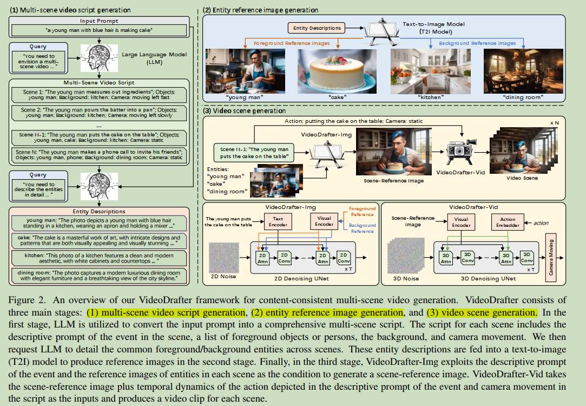
Method
4. VideoDrafter: Content-Consistent Multi-Scene Video Generation with LLM, Arxiv 2401, HiDream

Slide 24
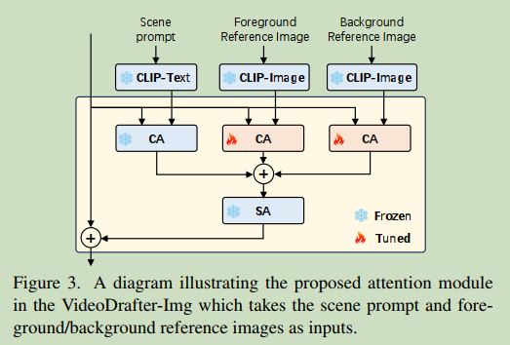
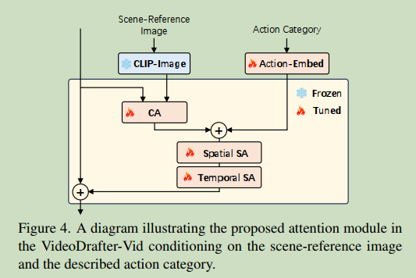
Method
Multi-Scene Video Script Generation
MLLM精细化prompt （很多方法都在用）
MLLM multi-round dialogue（可以借鉴）
Entity Reference Image Generation
Stable Diffusion 生成物体 + U²-Net Segment 去除背景
Video Scene Generation
VideoDrafter-Img + VideoDrafter-Vid (通过修改注意力实现）
4. VideoDrafter: Content-Consistent Multi-Scene Video Generation with LLM, Arxiv 2401, HiDream

Slide 25
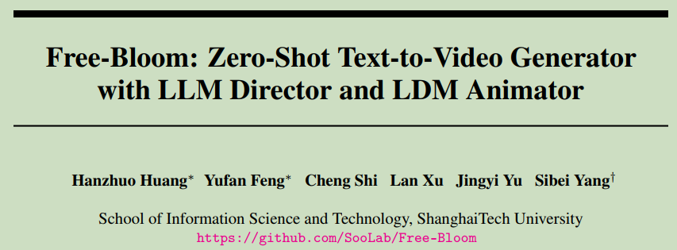
5. Free-Bloom: Zero-Shot Text-to-Video Generator with LLM Director and LDM Animator , NIPS2024, ShanghaiTech University

Slide 26
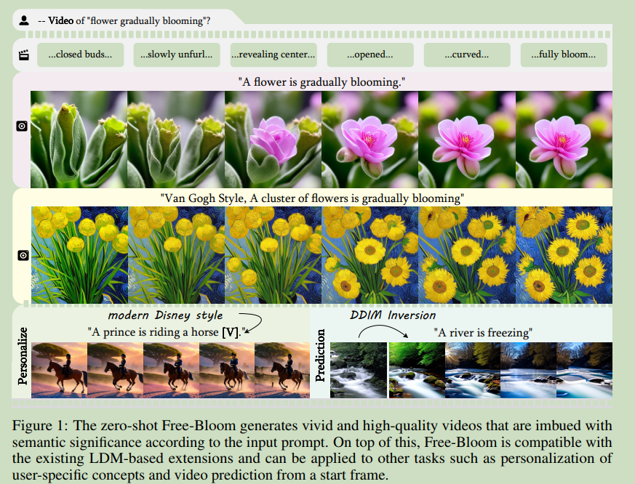
Arguments & Motivations
（1）not just “moving images”;
（2）cost-efficient and data-efficient.
文本-视频数据集相对较少
5. Free-Bloom: Zero-Shot Text-to-Video Generator with LLM Director and LDM Animator , NIPS2024, ShanghaiTech University

Slide 27
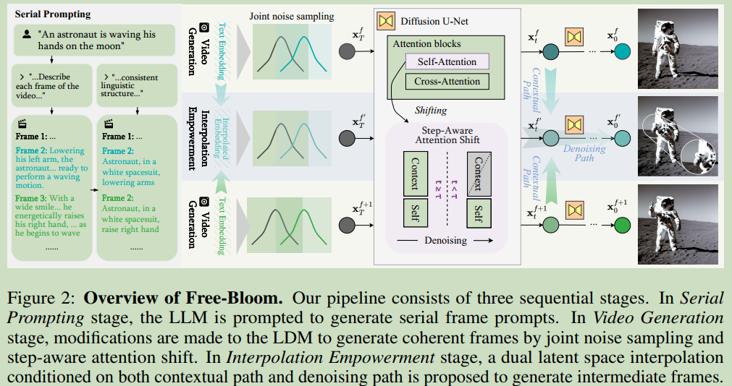
Method
LLM+LDM
5. Free-Bloom: Zero-Shot Text-to-Video Generator with LLM Director and LDM Animator , NIPS2024, ShanghaiTech University

Slide 28
Method
三个阶段：
（1）serial prompting
精细化prompt能够描述视频语义的变化
之后进一步结合分辨率描述每一帧的内容
（2）video generation
对LDM的两个修改实现semantic coherent, identical coherent, temporal coherent
Joint noise sampling folloing LDMs’ assumption (frame coherence)
Step-aware attention shift (identical, temporal, semantic coherence)
（3）interpolation empowerment
a dual interpolation path
(1)+(2)得到低帧率的视频，（3）得到高帧率视频。
LLMs incorporate extensive world knowledge and can provide temporal transition knowledge.（可以借鉴）
5. Free-Bloom: Zero-Shot Text-to-Video Generator with LLM Director and LDM Animator , NIPS2024, ShanghaiTech University

Slide 29
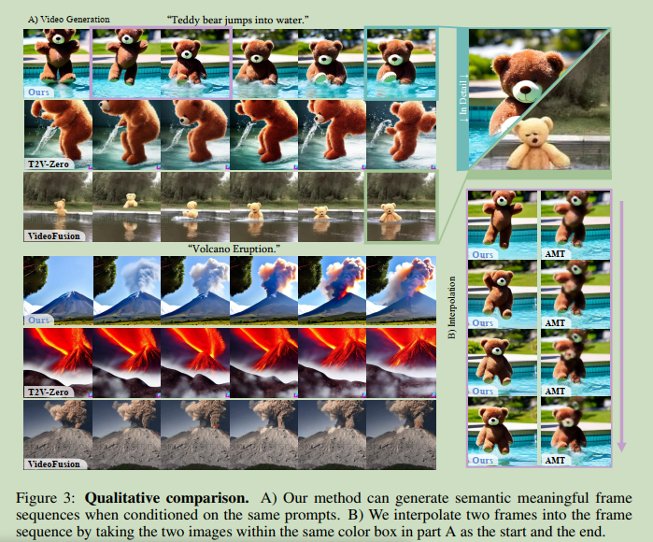
Experiments
5. Free-Bloom: Zero-Shot Text-to-Video Generator with LLM Director and LDM Animator , NIPS2024, ShanghaiTech University

Slide 30
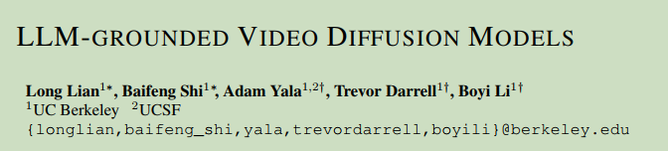
6. LLM-Grounded Video Diffusion Models, ICLR2024, UC Berkeley

Slide 31
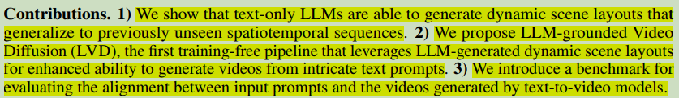
Arguments & Motivations & Contributions
(1) struggle with intricate spatio-temporal prompts
(2) generate restricted or incorrect motion
text-only LLMs are able to generate dynamic scene layouts that generalize to previously unseen spatiotemporal sequences（可以借鉴）
6. LLM-Grounded Video Diffusion Models, ICLR2024, UC Berkeley

Slide 32
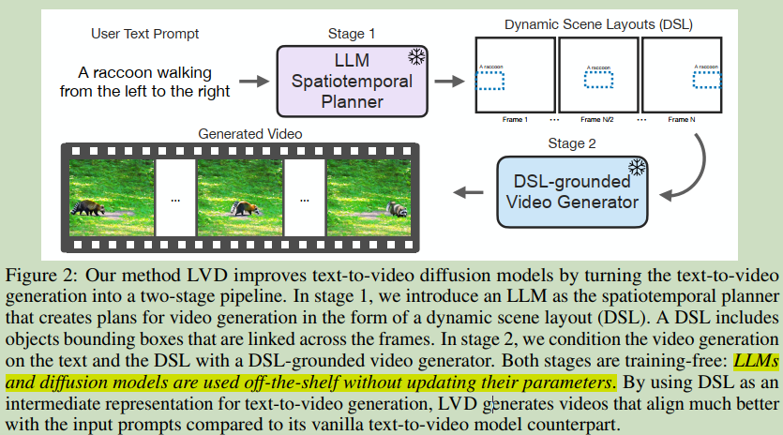
Method
LLM 得到 dynamic scene layout (DSL)
从 DSL 中生成视频
6. LLM-Grounded Video Diffusion Models, ICLR2024, UC Berkeley

Slide 33
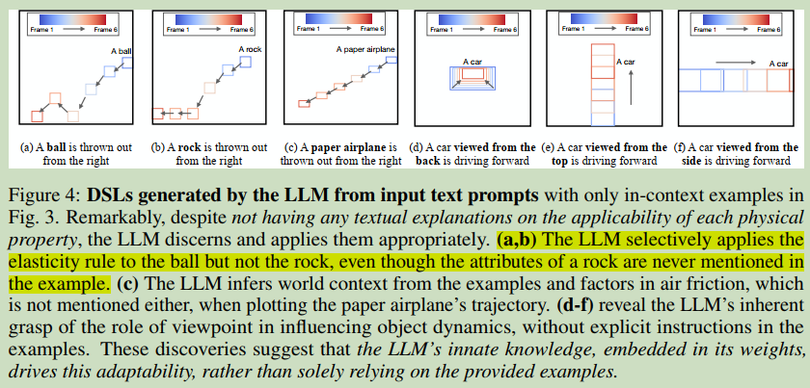
Method
LLM 的有趣性质，可以根据上下文确定物体的运动轨迹
6. LLM-Grounded Video Diffusion Models, ICLR2024, UC Berkeley

Slide 34
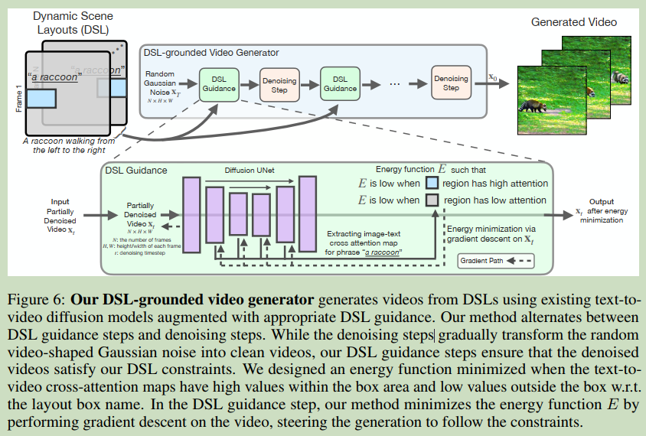
Method
从DSL中生成视频，不需要微调。
添加了基于注意力的引导DSL层。
6. LLM-Grounded Video Diffusion Models, ICLR2024, UC Berkeley

Slide 35
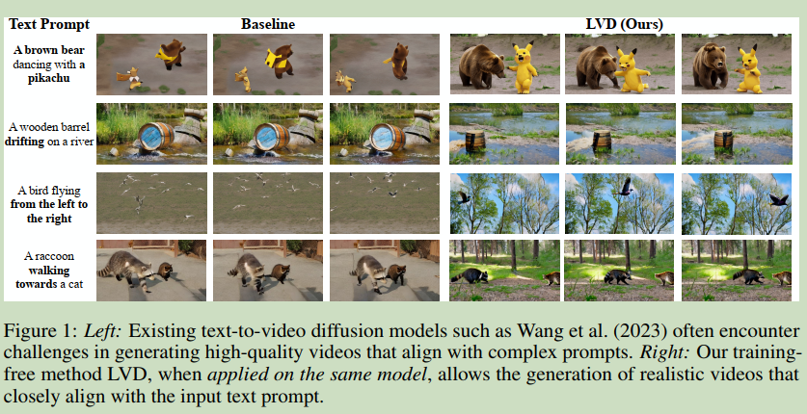
Experiments
6. LLM-Grounded Video Diffusion Models, ICLR2024, UC Berkeley

Slide 36
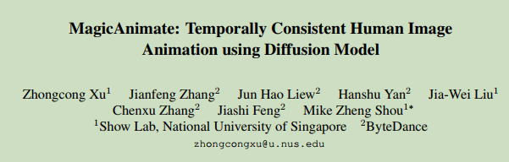
7. MagicAnimate: Temporally Consistent Human Image Animation using Diffusion Model, CVPR2024, ShowLab

Slide 37
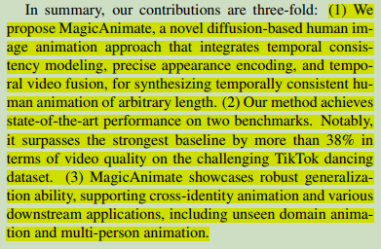
Arguments & Motivations & Contributions
Motivation: Generate a video of a certain reference identity following a particular motion sequence.
Arguments:
(1) the lack of temporal modeling
(2) poor preservation of reference identity
7. MagicAnimate: Temporally Consistent Human Image Animation using Diffusion Model, CVPR2024, ShowLab

Slide 38
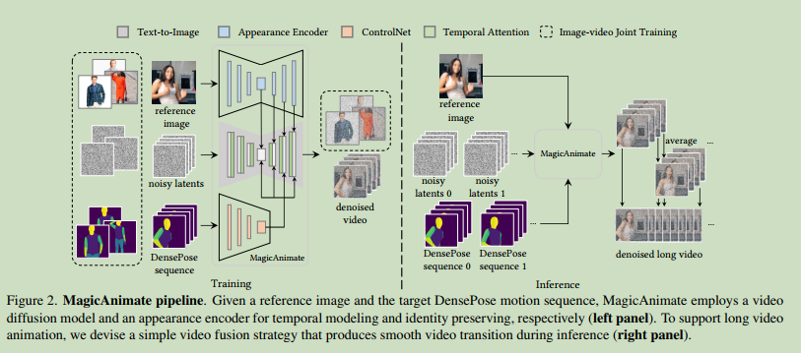
Method
两个ControlNet，分别对Pose和Reference Image进行处理
7. MagicAnimate: Temporally Consistent Human Image Animation using Diffusion Model, CVPR2024, ShowLab

Slide 39
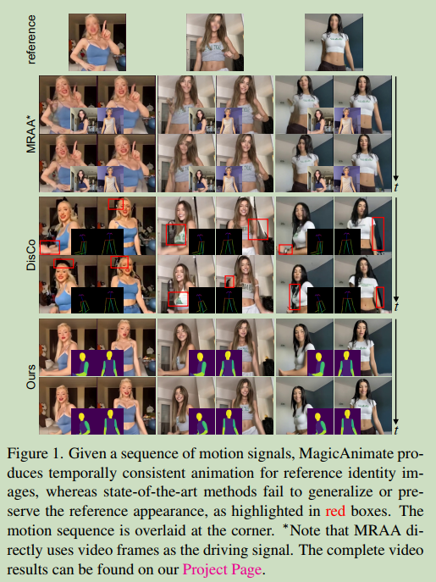
Experiments
7. MagicAnimate: Temporally Consistent Human Image Animation using Diffusion Model, CVPR2024, ShowLab

Slide 40
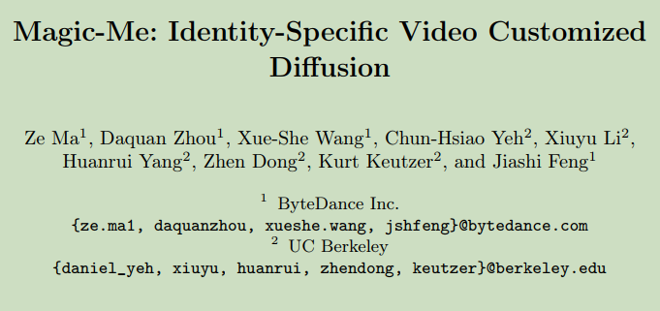
8.Magic-Me: Identity-Specific Video Customized Diffusion, Arxiv 2403, ByteDance Inc.

Slide 41
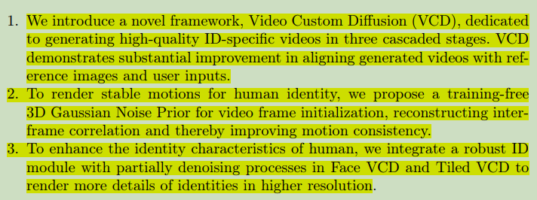
Arguments & Motivations & Contributions
Motivation: animate a human identity with diverse motions and scenes and preserve the identity’s characteristics.
Arguments:
(1) the lack of temporal modeling
(2) poor preservation of reference identity
8.Magic-Me: Identity-Specific Video Customized Diffusion, Arxiv 2403, ByteDance Inc.

Slide 42
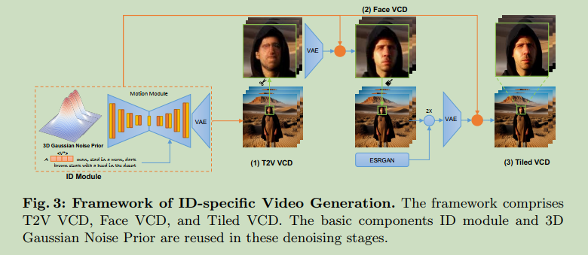
Method
8.Magic-Me: Identity-Specific Video Customized Diffusion, Arxiv 2403, ByteDance Inc.

Slide 43
Method
(1) T2V VCD: generate low-resolution video, the face is blurred
(2) Face VCD: regenerate the face with more identity characteristics
切割出人头的bounding box，提出视频然后精细化
（会不会存在细化后的人头视频不能跟原视频连接部分不契合的问题）
（如果人头位置在视频中发生移动结果可能受影响）
(3) Tiled VCD: upscale video
8.Magic-Me: Identity-Specific Video Customized Diffusion, Arxiv 2403, ByteDance Inc.

Slide 44
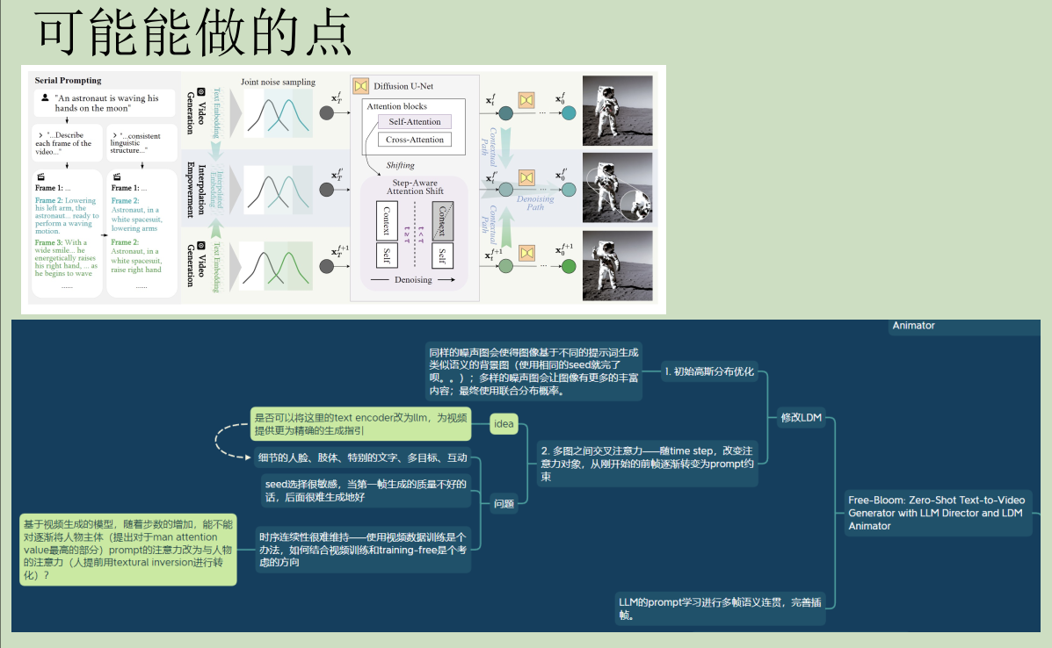
多次利用LLM反馈生成高质量的首帧

Slide 45
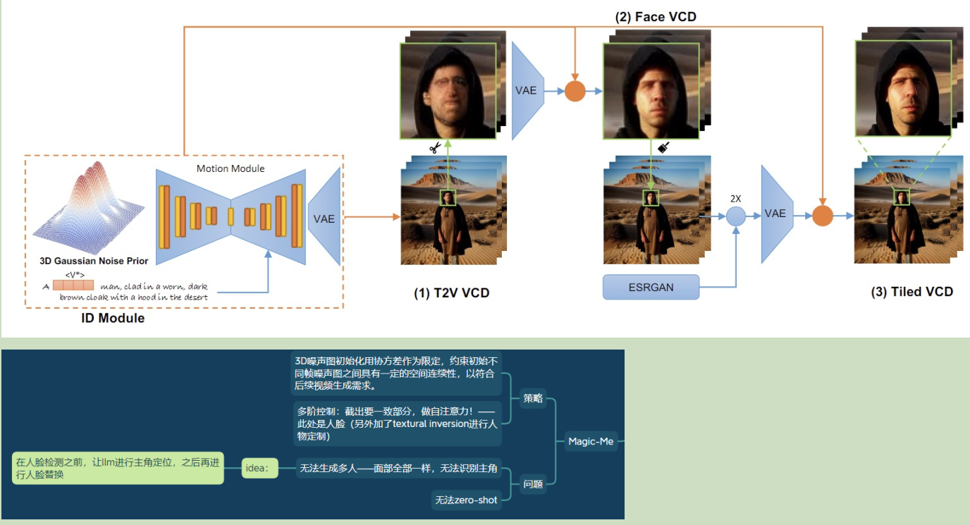
不能编辑视频

Slide 46
Zero-shot 视频生成和编辑
LLM 精细化prompt + segmentation
ID consistency

Slide 47
123防守打法
123中国人
3. Free-Bloom: Zero-Shot Text-to-Video Generator with LLM Director and LDM Animator, Shanghai Tech University, NIPS 2023

